Slide 1
CH3 Lists (of nodes)

Slide 2

Agenda
List basics
Singly Linked Lists
Doubly Linked Lists
Image: Pixabay

Slide 3

1. List Basics
= usually a set of elements one after another.
Indexed, so we can access elements by their index
In programming: List is usually a list of nodes, a concrete data structure with rules.
Image from Pixabay

Slide 4
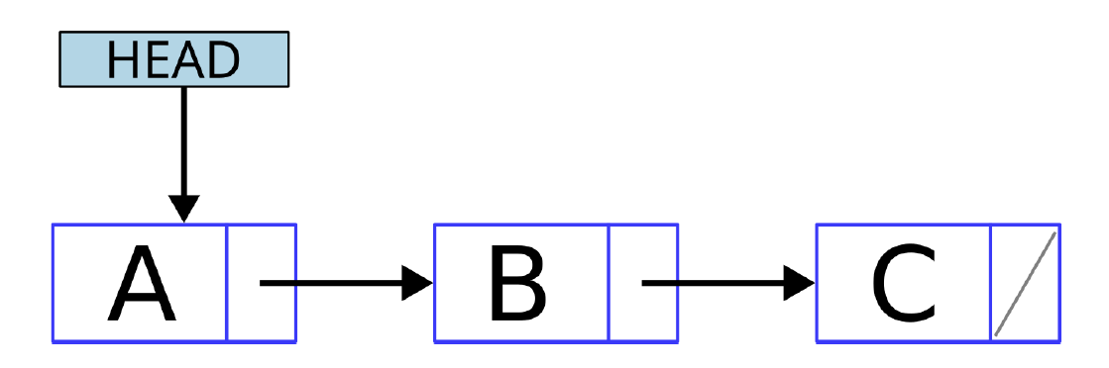
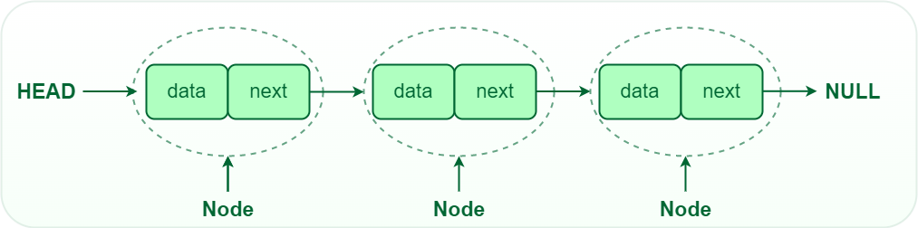
2. Singly Linked Lists
Nodes
Used to store data in Linked Lists
Pointer to the next node
Last node points to NULL (None in Python)
Pointer Structures
More in future chapters!
Image from Geeks for Geeks

Slide 5
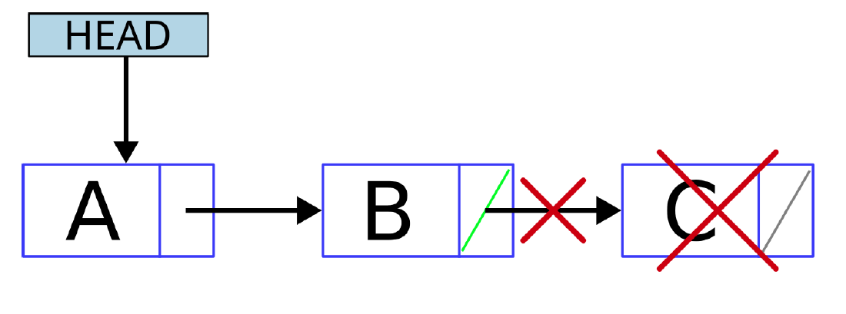
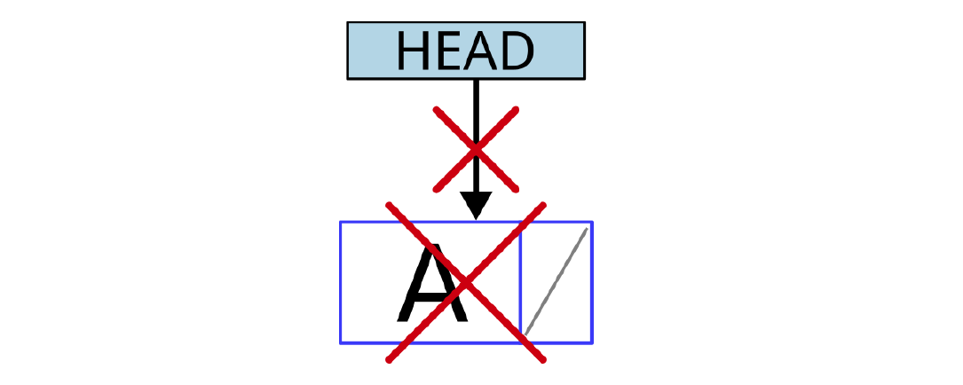
2.1. Practice time!
Turn to the Moodle environment and complete exercise 1 of the 3rd chapter, where you will have to implement a pop method.
To remove the last element/node, the node before it has to be located, because its next field has to be updated to None. (picture 1.)
When the list has only one node, the head has to be updated. (picture 2.)
Picture 1.
Picture 2.

Slide 6
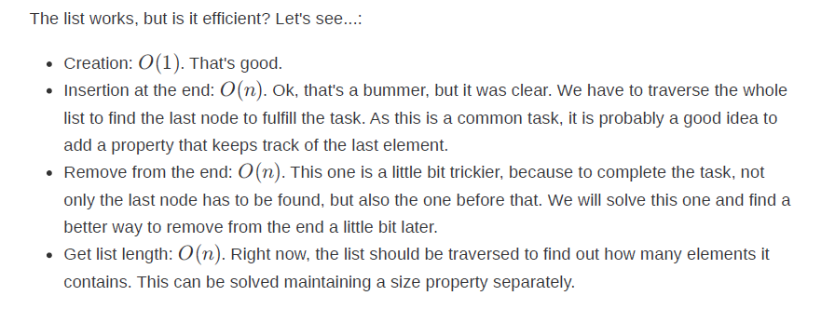

Slide 7
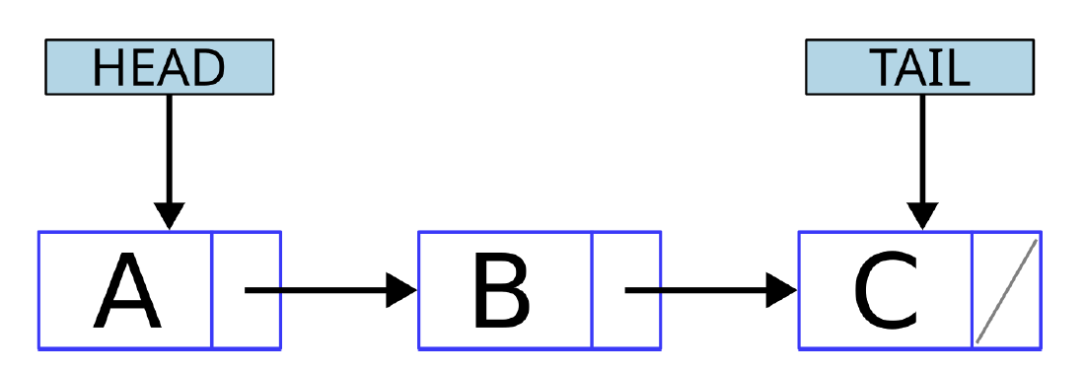
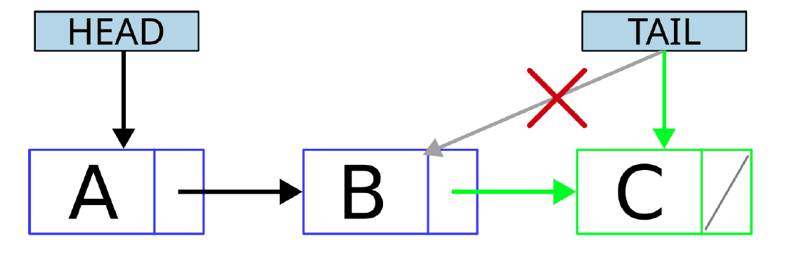
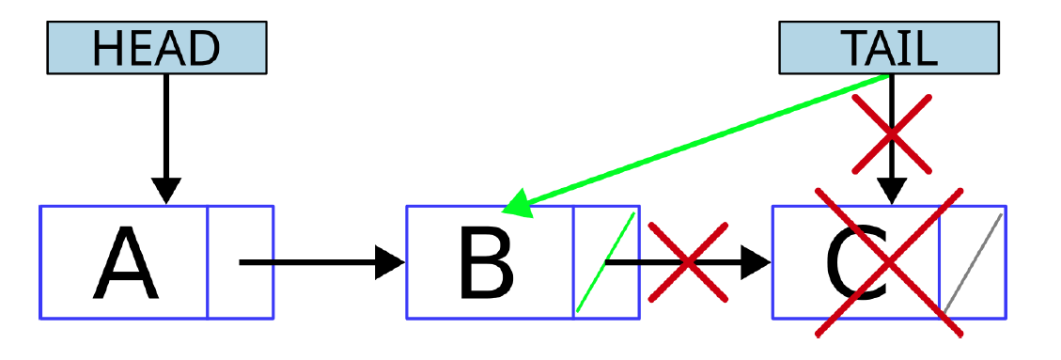
2.1. Singly Linked List with Tail
End of the list is called ‘Tail’
Size property + pointer to last element
Time to practice! Moodle CH3 Ex 2.
In this case we want to implement the pop method, and same as before, apart from deleting the last node, it has to update the pointer of the node before the last one and change the tail pointer to this node.
Picture 1.
Picture 2.
Picture 3.

Slide 8
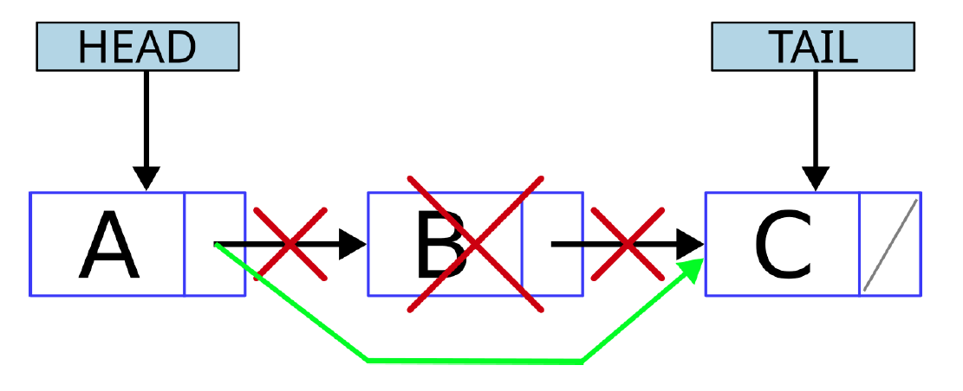
2.2. Singly Linked List with Tail
Time to practice! Moodle CH3 Ex 3.
Remove method. To help you with the task, an insert method will be also provided that works as an example.
The remove should take into account the same cases as before, but also when the node to remove is in the middle. (Picture 1). When this happens, head and tail pointers are not touched, but, as before, the pointer of the previous node should be updated. So, in this case we need to locate the node to be deleted and the nodes before and after it.
Picture 1.

Slide 9
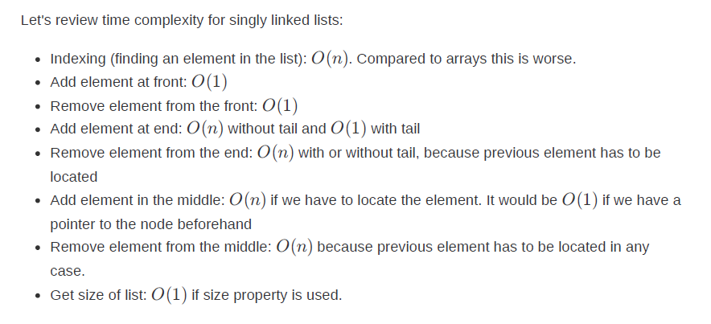

Slide 10
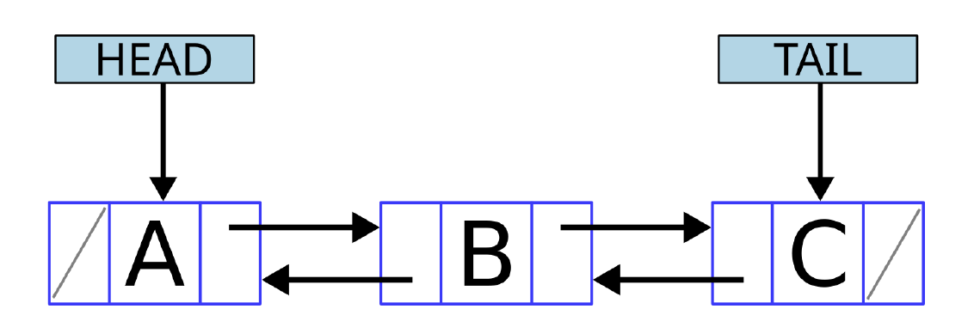
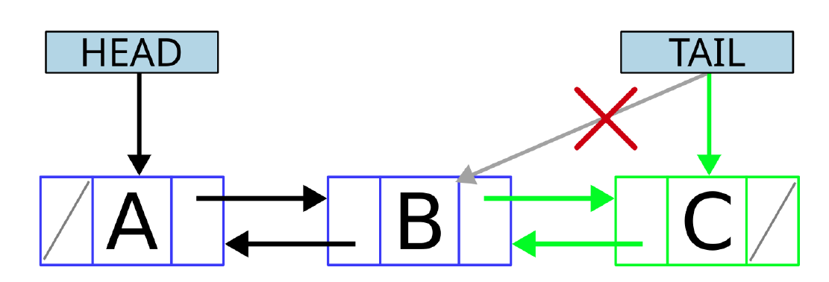
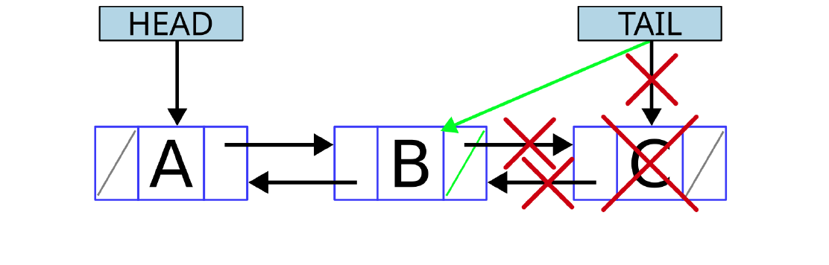
3. Doubly Linked Lists
Every node can have, in addition to the pointer to the next node, a pointer to the previous element. This is what is called Doubly linked list
From any node you can move forward or backwards! Very cool. (Picture 1.)
Append (picture 2.)
Pop (picture 3.)
Exercise time in Moodle again!
Ex 4: Insert method
Ex 5: Remove method
Picture 1.
Picture 2.
Picture 3.

Slide 11
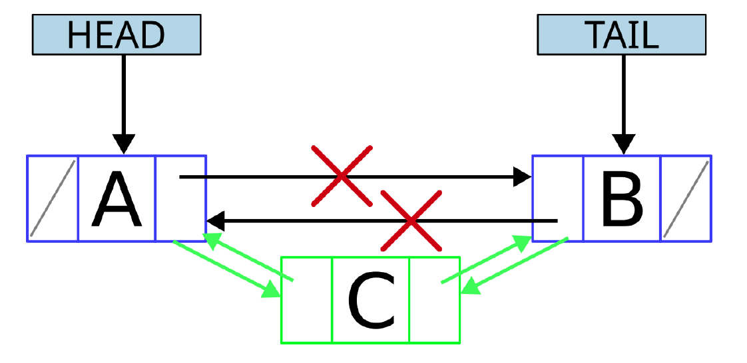
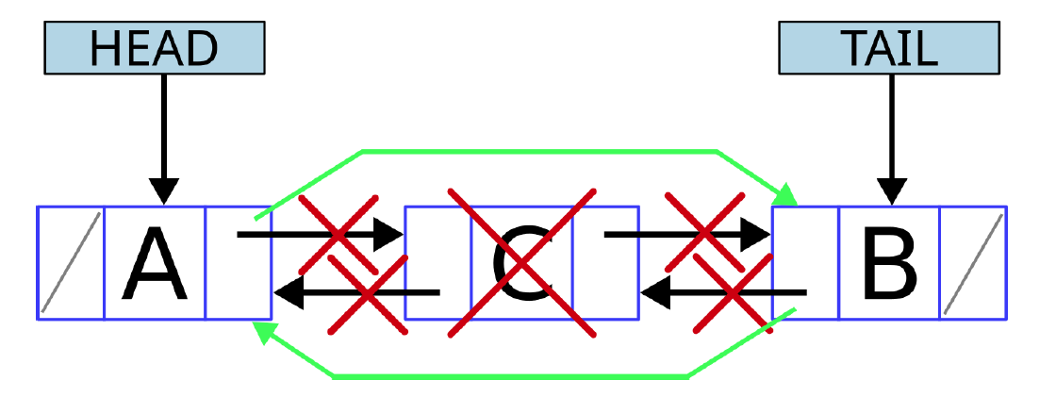
3.1. Doubly Linked Lists pt. 2
Ex 4:
Implement the insert method, which inserts a new element/node at a position given as a parameter. Locate the nodes that will be before and after the new node and update the necessary pointers. If the header pointer is affected, it should be updated. And the same happens with tail pointer. (Picture 1.)
Ex 5:
Implement the remove method, which removes an element/node from the position given as a parameter. Same as before, the process is quite straight: Locate the nodes before and after the one to remove and update the necessary pointers. If the header pointer is affected, it should be updated. And the same happens with tail pointers. (Picture 2.)
Picture 1.
Picture 2.

Slide 12
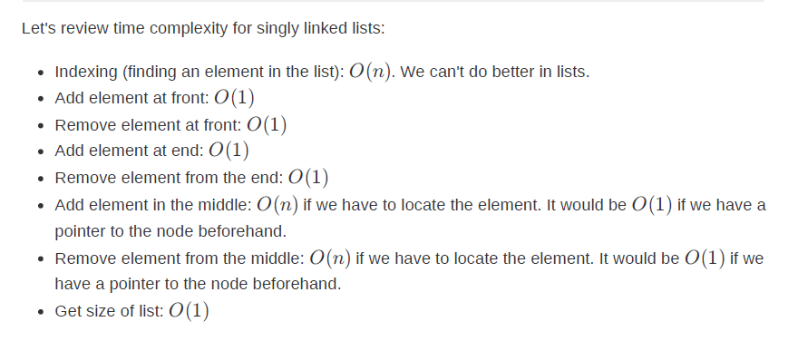

Slide 13
See you next time!
tino.kankkunen@metropolia.fi

